Slide 1
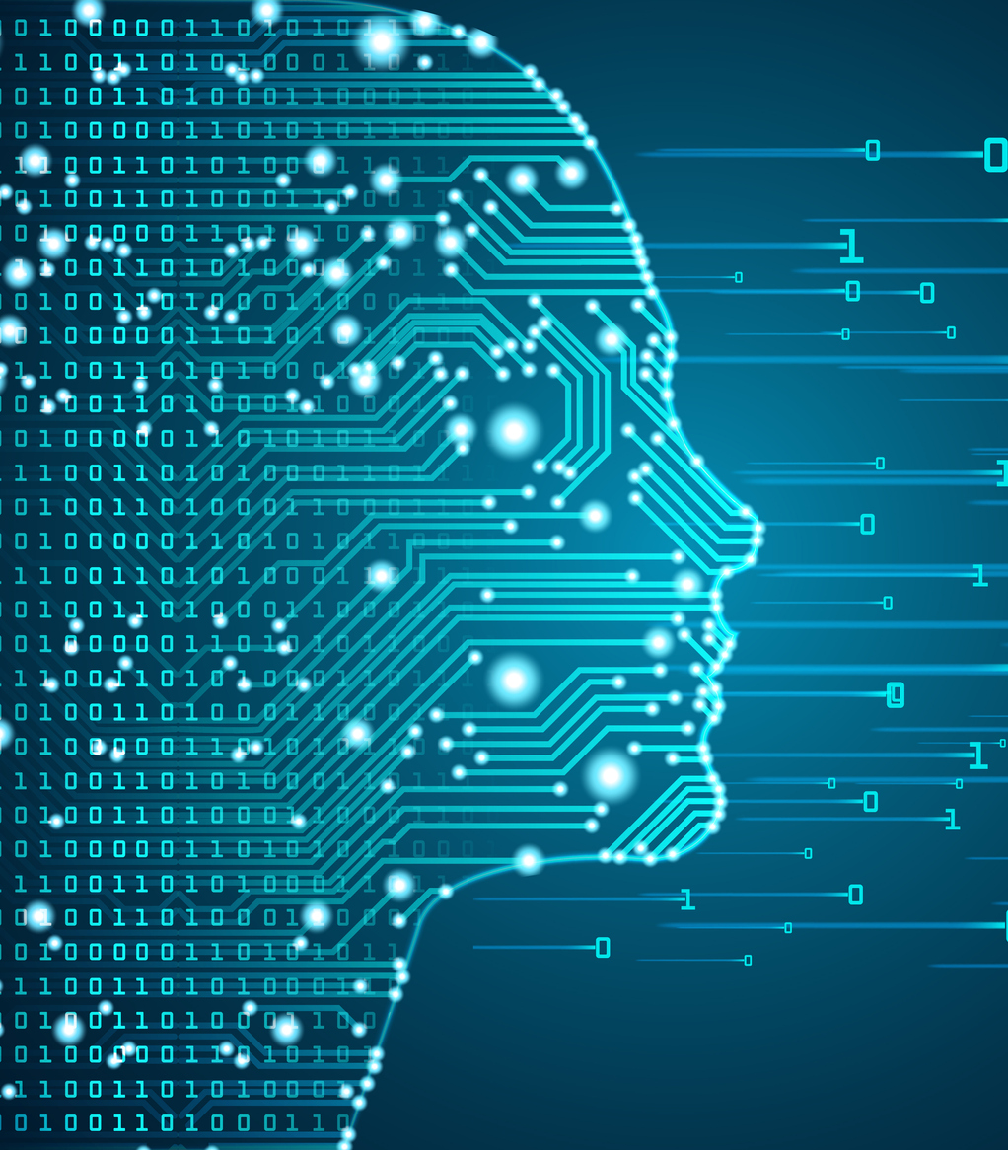
Don Juan’s Realism
Aaron Ottinger, PhD
aottinger@seattleu.edu / @AaronOttinger
Digital Technology and Cultures, Seattle University

Slide 2
Introduction: Which realism?
Realisms across disciplines
Literature, Film, Painting, Philosophy, Digital Humanities
Mathematics, Physics
Different brands of realism within each discipline
“Speculative realism” (SR) emerged within philosophy (2007-present)
SR migrated to literary studies (esp. studies in Romanticism) after 2012
Evan Gottlieb’s Romantic Realities (2016)
Chris Washington and Anne McCarthy’s Romanticism and Speculative Realism (2019)
Chris Washington, “Byron’s Speculative Turn: Visions of Posthuman Life in Cain” Essays in Romanticism (2015)
Brian Rejack, “An Object-Oriented Ontology of Media through Don Juan” (2016)
Notes:
My larger project is called Astral Romanticism and it is a study of the history of objectivity and it's role within human cognitive processes, namely, decision-making and world-making. Part of that project is an attempt to parse out the various realisms. If realism is regarded as a genre, then my inquiry asks, in part, how realist were Romantic-era texts?
My project was motivated in part by the resurgence of realism in philosophy, marked by Ray Brassier's translation of Quintin Meillassoux's After Finitude. I first wrote about this developing story in 2012 for the NASSR Graduate Student Caucus Blog, so a big shout out to them!
Since then we have seen the publication of two monographs on the subject. Perhaps no one has done more to promote the link between Romanticism and SR than Chris Washington, who has publish several articles and, as I mentioned before, co-edited the collection. To my knowledge there is at least one article on SR and Don Juan besides my own, by Brian Rejack. While I don't think "Speculative Realism" as a term holds much weight at this point in time, we can outline some criteria that speak to much present-day theory even beyond the sign of SR.

Slide 3
Speculative Realism: An Indictment of Romanticism?
Criticisms directed at Postmodernism/Romanticism:
Centering the human subject (Harman, Meillassoux, Brassier)
“Correlationist circle” (we can’t know x without naming x) (Meillassoux, Harman, Brassier)
The mind/world mirror (Brassier, Parisi)
Permanent renewal / eternal return (Brassier, Negarestani)
Privileging the will / volunteerism (Brassier)
Intellectual Intuition (Brassier)
Disparaging math, science, objectivity (Toscano, Brassier)
Notes:
“Consider the philosophical differences between Harman’s Object-Oriented Ontology, Grant’s neo-idealist Naturephilosophy, Meillassoux’s speculative materialism, and my own [Brassier’s] Sellarsian Transcendental naturalism. The first insists that only objects exist. The second defends a dynamic ontology of powers. The third proposes that the absolute is not what is but what could be. The last claims that thinking is embedded in a nature to which it is logically (though not causally) irreducible.” –Brassier

Slide 4
Don Juan, a Romantic Rejoinder
The narrator traffics between realms
he appears and disappears; occupies different presents; “limited omniscience”
Closer to 21st century depictions of digital guides than Dante’s Virgil
The narrator does not choose DJ; DJ chooses the narrator (?)
What’s really important is the importation of a variable from another text
Don Juan has an identity, but this “essence” is a destabilization of identity, similar to a number that is both 0 and 1 (Juan).
Unlike Wordsworth, Byron is unconcerned with a form that “mirrors nature” (representationally and/or metrically)
The form of this poem/map is mathematical yet open
Notes:
Byron’s Don Juan belongs to a group of literature, from the mid-eighteenth century to the first quarter of the nineteenth century, that offers a different kind of Romanticism, one that explores a weird kind of realism, characterized by multiple perspectives, abduction, a non-linear sequence of time, objects that straddle the mind/world divide, and totalizing structures that are simultaneously objective and undeteremined. Including Byron’s Don Juan among these texts is as much of a rejoinder to present-day “speculative realists,” as it is to the inherited view of Romanticism from M.H. Abrams, who excluded Byron from Natural Supernaturalism because of the “ironic counter-voice” that opened “a satirical perspective on the vatic stance of his Romantic contemporaries.” On the contrary, I argue that Byron's epic poem offers an image of totality in the making, but without the renewed nuptial between mind and nature. Instead, Byron creates an alternative world. It is a disturbing world for its canniness, with references to real places, people, and events. Yet by including a narrator, who is simultaneously nowhere and here, depending on how involved he gets in the action, as well as a fictional character whose existence rewrites history and defies the pace and scale of the nineteenth-century imagination, Byron constructs a text that at once belongs to history and the world but is logically irreducible to it, to borrow Brassier’s phrasing.

Slide 5
Stakes: Don Juan for the 21st Century
Romantic-era texts as models: What is a model?
Involves “mathematical relationships” that “correspond to down-to-earth relationships”
Reveals relations that were not apparent
Allows for experimentation where it would not otherwise be responsible (H. Paul Williams)
The narrator anticipates “cognizant texts” by choosing/selecting for us:
1700s-Romanticism: Print poetry and novels become more performative and involve the audience (Esterhammer)
Readers have to do the “calculating” for the text
DJ’s narrator anticipates “cognizant texts” (Hayles 2012) by making decisions for the reader
Complicates our understanding of a model/text’s realism:
The poem does not mirror “the world”; it butts up against it and thereby reveals aspects that would otherwise remain hidden:
Unlike “The Giaour,” this world is less fractured (Gottlieb) and more fractal, it’s mathematical yet undetermined, it’s axiomatic yet open
Intro-duces a variable (Don Juan) that upsets the stability of the text/model
Notes:
At a celebration of Don Juan’s 200th anniversary, it is worth asking, why have this conversation at all; or what does Don Juan have to do with today?
I have to remind everyone that I teach in Seattle U’s department of digital technology and cultures. It’s a nice fit because I tend to look at texts somewhat functionally.
And hence, Don Juan belongs to a group of works, including Tristram Shandy, Mary Wollstonecraft’s novels, and Wordsworth’s Lyrical Ballads, which I believe anticipate certain aspects of mathematical models and what Katherine Hayles calls cognizant texts.
The aim of these texts is not simply to deliver a message but to model, and thus perhaps alter, the way the mind works, much in the same way as Euclid’s Elements was intended to organize young pupils reasoning faculties.
Don Juan might seem like a strange choice, but the way that the narrator directly addresses the reader and the way that the story directly engages with actual living people, places, and events, the poem certainly blurs the line between a “fiction” and “reality.” In fact, I think it is fair to say that Don Juan is an experiment in world-making. But the poem does not merely mirror “the world”; it butts up against it and thereby reveals aspects that would otherwise remain hidden: namely, there is a way in which the world may be mathematical yet undetermined, axiomatic yet open. And these revelations follow from introducing a hero whose protean identity is his “essence,” and as we will see, that is not a bad description of certain kinds of data that may infect our own 21st-century models. The question is, if Don Juan really anticipates our current situation, what can it teach us about models and, moreover, about those strange entities inhabiting them and with whom we communicate, i.e. our guide, the narrator?

Slide 6
Where/When is the Narrator
The “speaker” of Euclid’s Elements exemplifies a narrator on the “objective” end of the spectrum
Byron’s narrator occupies an position similar to the Archimedean point “outside” the world, but he also participates in it
The narrator is a guide, like Dante’s Virgil, but he more closely resembles 21st-century guides, e.g. Janet from The Good Place
Notes:
If narrators appear on a spectrum between objectivity and subjectivity, the eighteenth and nineteenth-century’s most extreme example of an objective narrator is that of Euclid’s Elements. According to James Harris, in his 1751 Hermes or a Philosophical Inquiry Concerning Universal Grammar, Euclid contains “neither First person, nor Second” and “the reason is, that neither Speaker nor Party addressed […] can possibly become the Subject of pure Mathematics, nor indeed can anything else, except abstract Quantity, which neither speaks itself, nor is spoken to by another.” Harris pinpoints an eighteenth-century version of the nemocentric perspective, what Ray Brassier calls the “view from nowhere,” after Thomas Nagel. Byron’s narrator seems to occupy the opposite end of the spectrum, as the most subjective, local, and particular. Jerome McGann explains that the original narrative was actually intended to follow from a Spanish story-teller in 1809, but that’s not the version we have inherited. Marchand and Andrew Elfenbein equate Byron’s narrator with the poet himself. And yet, critics like Paul Fry and Jonathan Gross locate Byron’s narrator in the position of sublime spectator, face-to-face with an ungraspable object. For myself, and the stranger brand of Romantic-era realism I am outlining, a more robust realism follows from the narrator’s traffic between perspectives, to occupy a detached sublime view at one point, to comment not on the plot of Don Juan but on the existential world of Regency England the next, while also participating in the action of Don Juan, as in the dinner scene of canto 15.
In short, Byron’s narrator is a guide for the reader, resembling Dante’s Virgil. But because he transposes between existential reality and abstract representation, because he seems to know all and see all, and yet, because he remains tethered to the finite limits of the text, Byron’s narrator more closely resembles the anthropomorphized computer programs of today’s science fiction, a traveler for whom time is reducible to space.

Slide 7
The Function of the Narrator
He chooses Don Juan for his tale, much like the mathematician “postulates” a line
In the Platonic view, mathematical figures are drawn from the intellect, not external nature
For Byron, the literary figure extends from A (history) to B (the present)
He is the mediator in this intertextual exchange
Conclusion: It is because of the narrator’s special position, as a guide occupying a place between two realms, that allows him to treat fictional objects with the same ontological status as existential objects
Notes:
Of course, Tristram Shandy shares many of the same characteristics as Byron’s narrator. The difference is that Sterne's narrator models the story of his life and asks the audience to participate in it. Byron's narrator models the world, and of his own accord, introduces something that did not already belong to it.
In my article, I spend a lot more time talking about the process of selecting Don Juan, and comparing that act to a postulate in geometry. But I want to a couple points now that I didn’t make in the article:
First, if Don Juan the character is drawn from history, then he belongs to a fictional realm without existence, at least according to fictionalists, such as Stuart Brock. Literature and human culture set a limit on the figure’s ontological status.
And yet, by putting additional pressure on the act of selecting his hero, the fact that a fictional character can be introduced and mixed in with non-fiction variables, blurs the line between fiction and reality, especially if the fictional character elicits behaviors, beliefs, and relations that were not previously recognized.
Second, and I think more importantly: it is because of the narrator’s special position, as a guide occupying a place between two realms, that allows him to treat fictional objects with the same ontological status as existential objects

Slide 8
What is Don Juan?
Don Juan is “real or ideal,— / For both are much the same” (10.20.153)
The opening stanzas of the poem clarify the protagonist’s ontological status
Don Juan belongs to human history but can be recalled through adaptations
Juan is both “Don Joo-uhn/Joo-wan” and “Don Hwan”
Don Juan is both 0 and 1
Notes:
Lord Byron refers to the eponymous hero of Don Juan (1819-1824) as “real or ideal,— / For both are much the same” (10.20.153). This equivocation between real or ideal calls to mind the relationship between objects and their formal or mathematical concepts, a connection Byron reinforces when he claims, regarding Dante, that Beatrice was “Meant to personify the mathematics” (3.11.88). Accordingly, I take the reference to real and ideal as indicative of one of the poem’s central problems: What is the ontological status of a figure, character, or a hero? If a figure changes, is this change only an arbitrary difference, or is the figure’s formal essence also subject to change? It was an important distinction in the long eighteenth-century, for even nominalists held that a triangle is the same in all times and places. However, for the realist, the mathematical object exists irrespective of human thought. Is it possible then that Byron saw Don Juan, the character, as independent of the page?
While Don Juan may belong to the realm of human texts, Byron calls attention to the fact that he has recalled this character from the grave, for Don Juan was “Sent to the devil, somewhat ere his time” (1.1.8). Later he will make reference to Don Juan as a stage production. There is an explicit recognition that, among a list of “actual” people in the world, Byron’s hero belongs to a different domain of being, but like a bit of code, he can be reproduced time and again by re--introducing him to a new text/model.
If Byron can recall Don Juan the character, then it stands to reason that there is something stable that allows him to be recalled, much in the same way that, if we say triangle, the word really refers to a mathematical object, the sum of whose angles equal 180 degrees.
And yet, Byron challenges the accepted view of an unchanging identity. In addition to forcing readers to call Don Juan Don Juan, Byron also plays on the resemblance between Juan and one. In the fifth stanza, the name follows the word “none” and precedes “one,” locating Don Juan in list of integers between zero and one, the metrical rhyme reinforcing Juan’s fuzziness.
Here, Byron is taking to an extreme a tendency that emerges with the introduction of “Probability and character in the Eighteenth Century,” as Paul J. Korshin outlines. Coincident with the formalization of probability, Korshin sees a rise in multi-faceted characters. But Byron’s Don Juan is not simply multifaceted, he is capable of taking on any attribute assigned to his class, much like an object in computer programming.
I cannot help but speculate in this instance, that Juan’s, or Joo-whan’s, or Juanna’s malleable nature follows from the fact that he, unlike the poem’s other characters, is imported from literary history, and thus takes on the status of a constantly mutating datum. It reminds me of the way Luciana Parisi talks about algorithms in present-day architecture software that can be “infected by data that they are not able to compute” (89). Don Juan, likewise, is an indefinite quantity, and the only thing that separates him from his fellow characters is the fact that he has been re-intro-duced, as opposed to deduced or induced, and in this latest iteration, Juan figures or embodies that which cannot be rationally processed, again, as if he personifies a mathematics too complicated for Euclid or Newton.

Slide 9
Consequences of Intro-ducing Don Juan
If Don Juan is an infinite, indefinite quantity:
he may figure something like the “cognitive nonconscious” (Hayles 2017), which is normally filtered out by:
language
narrative
mathematics
or, By introducing such a variable the poem may have to “crunch” this data indefinitely
The poem will change as a consequence—will the world/mind it models?
Notes:
If this text is a model, let’s say, of consciousness, then introducing an indefinite infinite quantity like Juan, might equate with introducing a swarm of information that in a ”normal” human would be filtered out by what Katherine Hayles calls the ”cognitive nonconscious.” It is the difference between dealing with rational numbers and dealing with quantities that a rational mind cannot comprehend but are commonplace at the level of the cognitive nonconscious. For as Byron writes: “indigestion’s grand multiplication / Requires arithmetic beyond my forces” (15.69.548).
It is by unleashing such a chaotic mathematical object that makes the path to the poem’s final termination unpredictable. As Byron reminds us, whether Juan does this or that, “Is yet within the unread events of time. / Thus far, go forth, thou Lay! Which I will back / Against the same given quantity of rhyme” (11.90.712-13). He then ends the succeeding canto with, “When the body of the book’s begun, / You’ll find it of a different construction / From what some people say ’twill be when done” (12.87.689-90). The poem will “go forth,” not without end but also not ending within any foreseeable future. Furthermore, it will change, defying “construction[s]” based on what is already known: it is becoming what is unknown. And yet, the poem will remain formally consistent (“Against the same given quantity of rhyme”) in terms of the ottava rima, the mathematical form providing the objective framework for Byron’s epic.
What we have then is Byron’s attempt to house the uncountable, an axiomatization of the gut. No wonder the poem appears to extend without end, for the main variable introduced, the hero, will upset any attempt to contain him.

Slide 10
Conclusions
The focus on the narrator becomes more concentrated:
More and more, the narrator dominates the poem (Marchand)
The narrator is pushed to the ”edge of the void” (Ottinger)
We don’t really know why the narrator takes center stage, but in this respect the poem does seem broken
The text/model may correlate with the world less:
Correlation does not equal adequacy
The model may still say something about “reality”
Because the model is also real (in some respects) it may fundamentally alter the “reality” it was meant to mirror

